Slide 1
Computer Architecture Experiment
Topic 2. Pipelined CPU supporting
exception & interrupt
浙江大学计算机学院
2022年9月
Notes:
PPT中主要围绕实验所需进行讲解，如果想要深入了解相关内容，可以参考如下章节：
RISC-V手册 第10章 及 附录中的CSR相关指令

Slide 2
Outline
Experiment Purpose
Experiment Task
Basic Principle – Review Interruption & Exception
Operating Procedures – Exception in RISC-V
Operating Procedures – Exception Unit Design
Checkpoints
Notes:
实验的介绍分为如下部分：
实验目的
实验任务
基本原理介绍：在这一部分带大家一起复习有关中断与异常的知识
操作流程-RISC-V架构下的异常处理：这一部分主要是RISC-V的异常处理机制以及实验中如何处理特殊寄存器的更新
操作流程-异常单元设计：这一部分主要是实验中在流水线哪一阶段进行异常检测
实验验收指标

Slide 3
Experiment Purpose
Understand the principle of CPU exception & interrupt and its processing procedure.
Master the design methods of pipelined CPU supporting exception & interrupt.
master methods of program verification of Pipelined CPU supporting exception & interrupt.

Slide 4
Experiment Task
Design of Pipelined CPU supporting exception & interrupt.
Design datapath
Design Co-processor & Controller
Verify the Pipelined CPU with program and observe the execution of program

Slide 5
Revie 4.9 Interruption & Exception Outline
What’s Interruption & Exception ？
Why need interruption & exception？
How to deal with interruption & Exception in RISC V ?
Transfer control to exception handler & return from exception
Control status registers
CSR instructions
How to write an exception handler ?

Slide 6
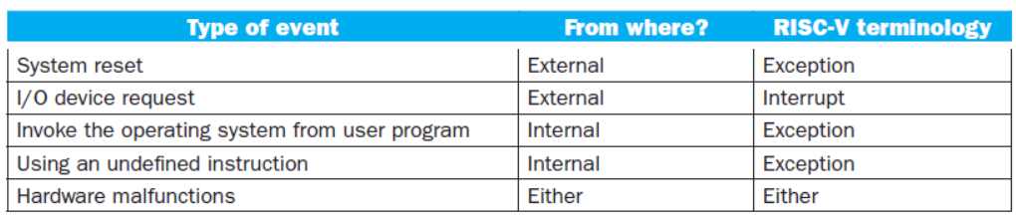
Revie 4.9 Interruption & Exception What’s Interruption & Exception?
The cause of changing CPU’s work flow :
Control instructions in program (bne/beq, jal , etc)
It is foreseeable in programming flow
Something happen suddenly (Exception and Interruption)
It is unpredictable
Call Instructions triggered by hardware
Exception
Arises within the CPU when execute
instruction
e.g., overflow, undefined opcode, syscall, …
Interrupt
From an external I/O controller
Dealing with them without sacrificing performance is hard

Slide 7
Revie 4.9 Interruption & Exception Why we need interrupt ?
When you double click the mouse ……
When a network package arrives ……
When you want to print a sentence on screen ……
Event external to the running program can interrupt the processor : ex Interruption driven I/O
polling ----waste a lot of processor time
Interruption driven I/O
DMA ---- direct memory access

Slide 8
Revie 4.9 Interruption & Exception Why we need interrupt ?
Processor can be interrupted by exceptional events that occur while the program is running that are caused by the program itself.
Example:
Page fault:
need OS to load the page into the memory from disk, then resume the program
Memory address fault ( segmentation fault )
Undefined opcode
The OS will stop the program and then transfer to other process.

Slide 9
Revie 4.9 Interruption & Exception How to handle exceptions
Read cause, and transfer to relevant handler
Determine action required
If restartable
Take corrective action
use SEPC to return to program (mret)
Otherwise
Terminate program
Report error using SEPC, SCAUSE, …
OS make the choice to transfer to another ready process

Slide 10
Revie 4.9 Interruption & Exception How to handle exceptions
Save PC of offending (or interrupted) instruction
In RISC-V: Supervisor Exception Program Counter (SEPC)
Save indication of the problem
In RISC-V: Supervisor Exception Cause Register (SCAUSE)
64 bits, but most bits unused
Exception code field: 2 for undefined opcode, 12 for hardware malfunction, …
Jump to handler
Assume at 0000 0000 1C09 0000_{hex}
Entry address in a special register :Suptervisor Trap Vector (STVEC), which can be loaded by OS.

Slide 11
Revie 4.9 Interruption & Exception How to handle exceptions: An Alternative Method
Vectored Interrupts
Handler address determined by the cause
Exception vector address to be added to a vector table base register:
Undefined opcode 00 0100 0000two
Hardware malfunction: 01 1000 0000two
…: …
Instructions either
Deal with the interrupt, or
Jump to real handler

Slide 12
Operating Procedures: Exceptions in RISC-V Outline
Transfer control to exception handler & return from exception
Control status registers
CSR instructions
How to write an exception handler ?

Slide 13
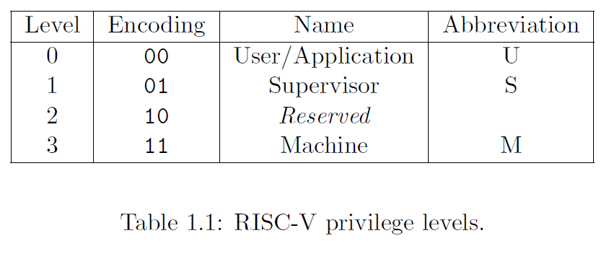
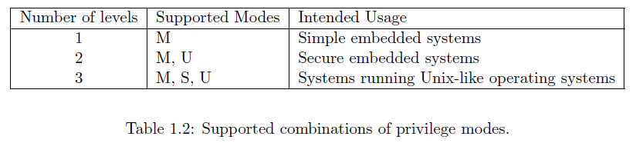
Operating Procedures: Exceptions in RISC-V Privileged level
Privilege Level in RISC V
Provide protection between different components of the software stack
Notes:
RISC-V 特权指令集中定义了几种特权模式
权限最高的模式为 M-mode，它拥有对机器底层的一切访问
我们的系统没有操作系统参与进来，所以只聚焦于M-mode

Slide 14
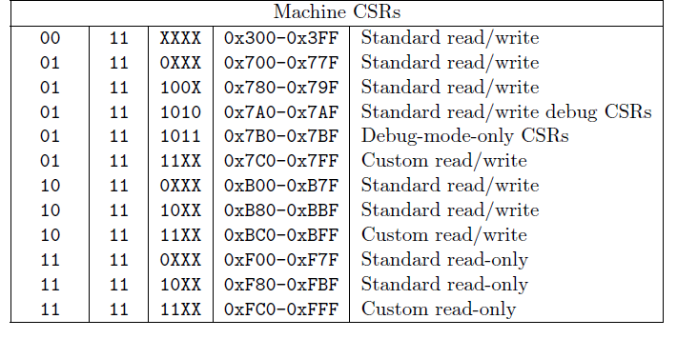
Operating Procedures: Exceptions in RISC-V CSR Address Mapping Convention
CSR[11..0] 4096
12 bit encoding space
The lowest privileged level that can access CSR
11: read only
00/01/10: read/write
Notes:
CSR控制与状态寄存器是支撑 RISC-V 特权指令集的一个重要概念。
CSR 是 CPU 中的一系列特殊的专用寄存器，这些寄存器能够反映和控制 CPU 当前的状态和执行机制。
我们实验中处理中断异常时需要读写CSR寄存器，获取和控制CPU状态
CSR 的地址空间有 12 位，因此理论上能够支持最多 4,096 个 CSR。但实际上，这个地址空间大部分是空的，访问不存在的 CSR 将触发无效指令异常

Slide 15
Operating Procedures: Exceptions in RISC-V 8 important CSR for exception handling
8 CSR :
mtvec ( Machine Trap Vector): jump to this address when exception
mepc (Machine Exception PC): the instruction raise the exception
mcause (Machine exception Cause): which kind of exception(cause)
mie (Machine Interrupt Enable): which exception can be handled or negleted
mip (Machine interrupt pending): pending interruptions (read only register)
mtval (Mahine trap value): error address , illegal instruction, or 0
mstatus ( Machine status) : processor status
Notes:
这里列出了中断异常处理中一些常用的CSR寄存器

Slide 16
Operating Procedures: Exceptions in RISC-V 8 important CSR for exception handling Ch Ver.
名称 | 全称 | 描述
mtvec | Machine Trap-Vector Base-Address Register | 定义进入异常的程序PC地址
mcause | Machine Cause Register | 反映进入异常的原因
mtval | Machine Trap Value Register | 反映进入异常的信息
mepc | Machine Exception Program Counter | 用于保存异常的返回地址
mstatus | Machine Status Register | 处理器状态，mstatus的MIE域和MPIE域用于反映全局中断使能
mie | Machine Interrupt Enable Registers | 用于控制不同类型中断的局部中断使能
mip | Machine Interrupt Pending Registers | 反映不同类型中断的等待状态
Notes:
这里列出了中断异常处理中一些常用的CSR寄存器

Slide 17
Operating Procedures: Exceptions in RISC-V 8 important CSR - mtvec
base[31..2] mode
Store the interruption handler entrance address
The base can be explained according to mode code
00(Direct Mode): PC ←base
x1(vector mode): PC ← mtval – 1 + 4x ( not required)
Notes:
直接模式（direct），所有类型的中断均发送给同一个中断响应程序。
向量化模式（vectored），中断 将根据 Cause 发送给不同的中断响应程序，但所有的 异常 仍然发送给 同一个 异常响应程序
实验中采用的直接模式

Slide 18
Operating Procedures: Exceptions in RISC-V 8 important CSR - mepc
Save the instruction address when exception raised or interruption happens.
the PC indicate the instruction that raise the exception
the instruction need to be executed after back from interruption
next instruction
Exception: mepc <- PC
Interruption: mepc <- PC + 4
Notes:
Mepc存储了异常程序的返回地址。因为一些异常比如page fault, 在page分配好了之后，需要恢复执行，中断处理完之后，也要回到中断位置继续执行
因此，在异常发生时，硬件会自动更新mepc的值到当前遇到的异常指令
注意，狭义的异常发生时mepc更新为PC，中断发生时mepc被更新为PC+4
原因大家可以思考一下

Slide 19
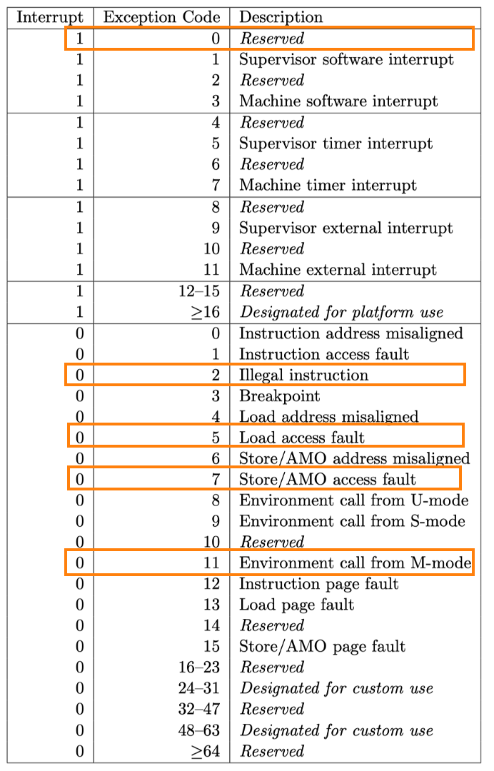
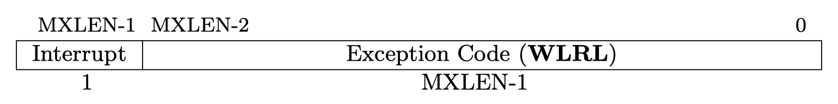
Operating Procedures: Exceptions in RISC-V 8 important CSR - mcause
If mcause[31] == 1 then the trap was caused by an interruption.
Exception code field: a code identifying the last exception.
Notes:
Mcause寄存器存储了异常发生的原因，其最高位表明这是不是一个中断
我们实验的异常局限于这几种：
非法指令
ECALL
L/S 地址超范围

Slide 20
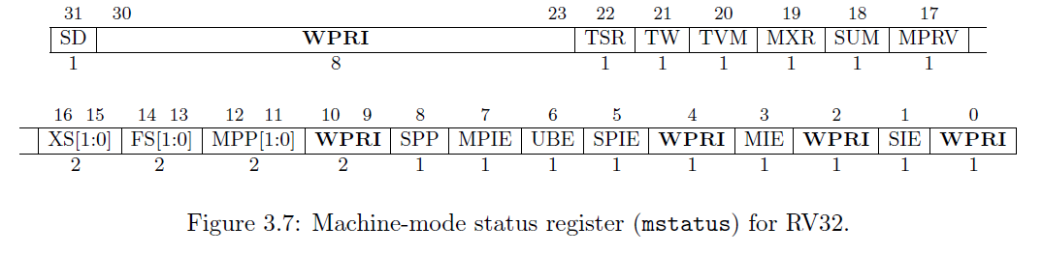
Operating Procedures: Exceptions in RISC-V 8 important CSR - mstatus
MIE: interruption enable (global ) (different from the MIE register )
MPIE: Previous MIE
mstatus.MIE=1 全局中断打开 mstatus.MIE=0 全局中断关闭
When an interruption/ exception raised: mstatus.MPIE = mstatus.MIE;mstatus.MIE = 0;
When MRET is executed: mstatus.MIE = mstatus.MPIE;
Notes:
Mstatus记录了当前处理器的状态，比较重要的是MIE, MPIE
MIE是全局中断使能，MIE为0表示禁止中断/异常响应，为1表示允许中断/异常响应
RISC-v架构规定异常发生时,其他所有中断都不再响应

Slide 21
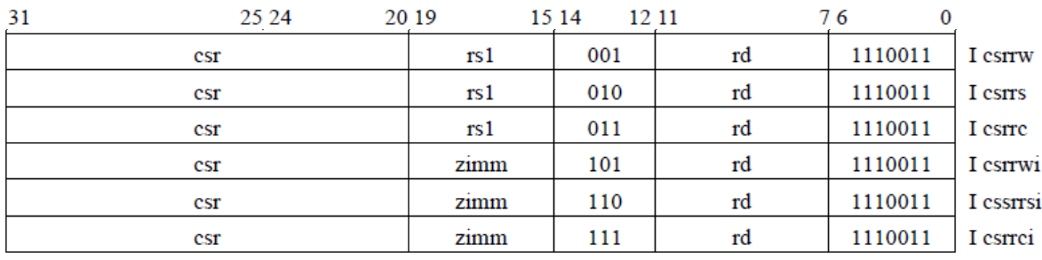
Operating Procedures: Exceptions in RISC-V CSR instructions
Notes:
CSR寄存器需要特定的CSR指令来操作，
考虑一段中断处理程序，为了读写mstatus, mepc等CSR寄存器，我们就需要CSR指令
这部分大家可以自己去阅读一下

Slide 22
Operating Procedures: Exceptions in RISC-V CSR instructions
csrrw rd, csr, rs1: t←CSRs[csr], CSRs[csr]←x[rs1], x[rd]←t
csrrs rd, csr, rs1: t←CSRs[csr], CSRs[csr] ←t | x[rs1], x[rd]←t
csrrc rd, csr, rs1: t←CSRs[csr], CSRs[csr] ←t & ~x[rs1], x[rd]←t
csrrwi rd, csr, zimm[4..0]: x[rd] ←CSRs[csr], CSRs[csr]←zimm
cssrrsi rd,csr,zimm[4..0]: t←CSRs[csr], CSRs[csr]←t | zimm; x[rd]←t
csrrci rd, csr, zimm[4..0]: t←CSRs[csr], CSRs[csr]←t&~zimm; x[rd]←t

Slide 23
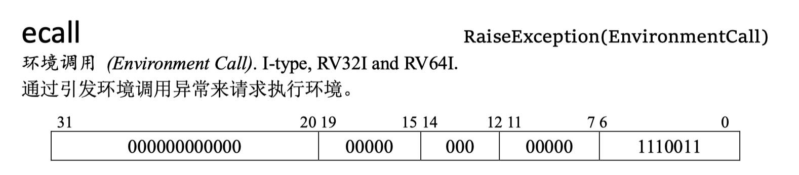
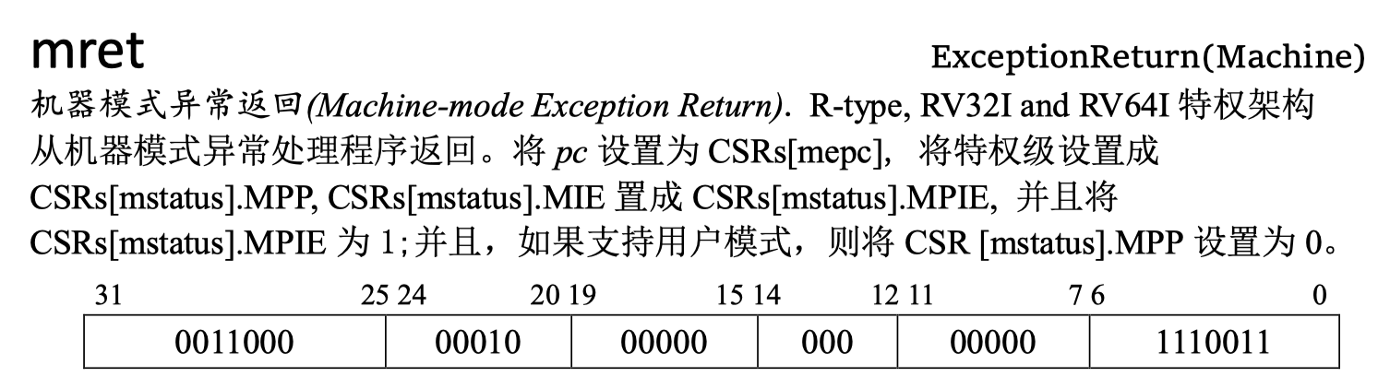
Operating Procedures: Exceptions in RISC-V
Other Instruction
Notes:
然后时一些和中断异常相关的指令
Ecall指令
ECALL是实现privilege跳转的指令，比如系统调用，一个用户程序需要调用OS提供的功能。
ECALL最终要回到调用的代码处的。Ecall发生时,将pc写入mepc，但是如果回来回到ecall的地址就会无限循环，ECALL的handler里最终可能要把MEPC加上4把ECALL跳过去、跳到ECALL后面的指令。
MRET指令从异常返回

Slide 24
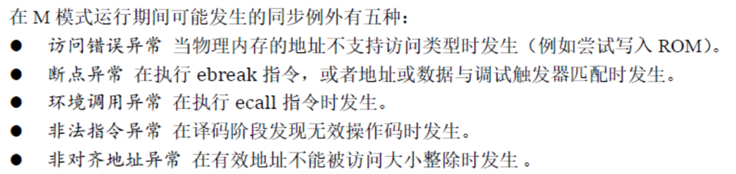
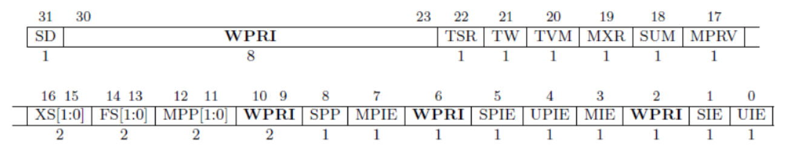
Operating Procedures: Exceptions in RISC-V Pipelined CPU supporting exception & interrupt
Machine-mode status register (mstatus) for RV32.
Notes:
再次明确一下，我们需要处理的仅有：
非法指令
ECALL
L/S 地址超范围

Slide 25
Operating Procedures: Exceptions in RISC-V Enter into Exception
Only enter when:
mstatus.MIE = 1 && mie[i] = 1 && mip [i]= 1
STOP pipeline，Run from mtvec
Update CSRs
mcause
mepc (interruption: PC+4, exception: PC)
mstatus (mstatus[7]=mstatus[3], mstatus[3]= 0)
mstatus.mpp ← mp; （Optional）
mp ← 11 （Optional）
Notes:
发生异常/中断时，硬件自动经历如下的状态转换：
异常指令的PC被保存在mepc中，PC被设置为mtvec。mepc指向导致异常的指令；对于中断，它指向中断处理后应该恢复执行的位置。
根据异常来源设置mcause，并将mtval设置为出错的地址或者其它适用于特定异常的信息字。
把控制状态寄存器mstatus中的MIE位置零以禁用中断，并把先前的MIE值保留到MPIE中。
发生异常之前的权限模式保留在mstatus的MPP域中，再把权限模式更改为M。(本次实验中也可以不做，因为没有操作系统，不涉及模式转换）

Slide 26
Operating Procedures: Exceptions in RISC-V Return from Exception (mret)
STOP pipeline，Run from mepc
Update CSRs
mstatus (mstatus[3] = mstatus[7])
mp ← mstatus.mpp （Optional）
Notes:
离开异常/中断时：
恢复先前的PC。
恢复先前的MIE。
同上，模式转换可以不做

Slide 27
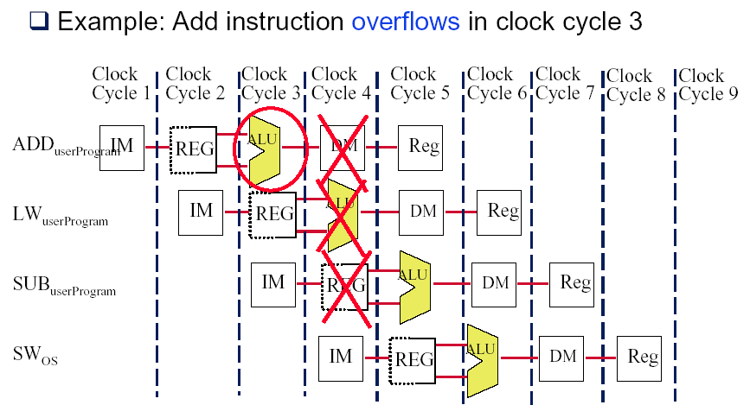
Operating Procedure : Exception Unit Design Flow of Instructions During Exception
Notes:
当流水线发生异常时，其后的指令应当停止执行

Slide 28
Operating Procedure : Exception Unit Design Precise Exceptions
If the pipeline can be stopped so that the instructions issued before the faulting instruction complete, then the pipeline is said to implement precise exceptions
All instructions before the faulting instruction complete
And instructions following the faulting instruction, including the faulting instruction, do not change the state of the machine.
Under this model, restarting is easy:
Simply re-execute the original faulting instruction.
Or, if it is not a resumable instruction, i.e. an integer overflow, start with the next instruction.
Notes:
处理异常往往有两种机制，第一种是Precise Exceptions
这种模式下恢复流水线很简单
我们的实验采用这种机制

Slide 29
Operating Procedure : Exception Unit Design Imprecise Exceptions
Difficult to do when some instructions take multiple cycles to complete
Some instructions may complete before an exception is detected
Example
Multiply r1, r2, r3 ; multiply takes 10 cycles
Add r10,r11,r12 ; add takes 5 cycles
Add will complete before multiply is done. If multiply overflows, thenan exception will be raised AFTER the add has updated the value in R10.
This is an imprecise exception.
Notes:
第二种机制是Imprecise Exceptions
这一机制处理较为复杂

Slide 30
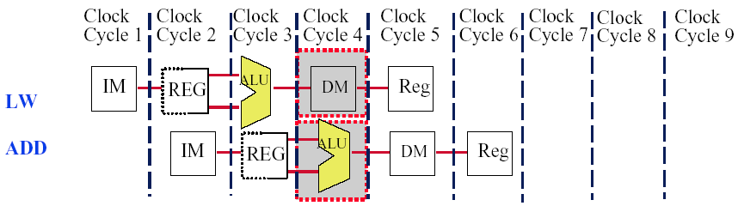
Operating Procedure : Exception Unit Design Multiple Exceptions in one clock cycle
In Clock Cycle 4, LW can have a data page fault while the ADD has an arithmetic exception
Handled by servicing the page fault and then restarting the LW instruction
The ADD’s arithmetic exception will occur again because the ADD instruction is restarted after the exception is handled
Notes:
实际的流水线中发生异常的情况可能较为复杂，什么时候去检测并处理异常值得思考
第一个例子是同一周期发生多个异常

Slide 31
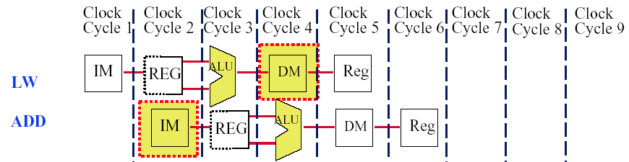
Operating Procedure : Exception Unit Design Multiple Exceptions out-of-order
ADD causes an exception in the instruction fetch stage while LW causes an exception in the memory access stage
If we implement precise exceptions, LW exception must be handled first
This is done by having hardware post exceptions by order of instruction
Notes:
第二个例子是靠后的指令在较早的周期中发生异常。成为乱序多发异常

Slide 32
Operating Procedure : Exception Unit Design Which stage can exceptions occur in?
Stage Problem exceptions occurring
IF page fault on instruction fetch;
misaligned memory access;
memory protection violation
ID undefined or illegal opcode
EX arithmetic exception
MEM page fault on data fetch;
misaligned memory access;
memory-protection violation
WB none
Notes:
通过分析异常可能发生阶段，我们可以发现在WB阶段不会发生异常
因此我们统一在指令的这一阶段检测指令在前4个阶段是否触发了异常

Slide 33
Operating Procedure : Exception Unit Design Exception ordering
When the instruction is about to exit the pipeline (MEM/WB), any pending exceptions for the instruction are examined.
If an instruction generates multiple exceptions, the exception occurring in the earliest stage takes precedence.
This is done by keeping an exception vector for each instruction:
If an exception is posted, it is added to the vector and all writes that affect system state are disabled.
Notes:
在WB阶段处理异常的详细机制解释

Slide 34
Operating Procedure : Exception Unit Design Conclusion
1. When an exception is raised, there are several instructions flying in the pipeline, how to stop the pipeline at the right place and safely shutdown the pipeline ?
If an exception is posted, it is added to the vector and all writes that affect system state are disabled
Record the correspond cause and information ( such as memory address )
2. How to keep the right exception ordering ?
Trap when there is exception or interruption at the stage of WB

Slide 35
Operating Procedure Pipelined CPU supporting exception & interrupt

Slide 36
Operating Procedure State Diagram supporting exception & interrupt
Notes:
一个在设计ExceptionUnit时比较好用、可供参考的状态图

Slide 37
Instr. Mem.(1)
NO. | Instruction | Addr. | Label | ASM | Comment
0 | 00000013 | 0 | __start: | addi x0, x0, 0
1 | 00402103 | 4 |  | lw x2, 4(x0)
2 | 00802203 | 8 |  | lw x4, 8(x0)
3 | 00c02283 | C |  | lw x5, 12(x0)
4 | 01002303 | 10 |  | lw x6, 16(x0)
5 | 01402383 | 14 |  | lw x7, 20(x0)
6 | 306850f3 | 18 |  | csrrwi x1, 0x306, 16
7 | 306020f3 | 1C |  | csrr x1, 0x306
8 | 306310f3 | 20 |  | csrrw x1, 0x306, x6
9 | 306020f3 | 24 |  | csrr x1, 0x306
10 | 00000013 | 28 |  | addi x0, x0, 0
11 | 07800093 | 2C |  | addi x1, x0, 120
12 | 30509073 | 30 |  | csrw 0x305, x1
13 | 00000013 | 34 |  | addi x0, x0, 0
14 | 00000073 | 38 |  | ecall

Slide 38
Instr. Mem.(2)
NO. | Instruction | Addr. | Label | ASM | Comment
15 | 00000013 | 3C |  | addi x0, x0, 0
16 | 00000012 | 40 |  | addi x0, x0, 0 | # change to illegal
17 | 00000013 | 44 |  | addi x0, x0, 0
18 | 07f02083 | 48 |  | lw x1, 127(x0)
19 | 08002083 | 4C |  | lw x1, 128(x0) | # l access fault
20 | 00000013 | 50 |  | addi x0, x0, 0
21 | 08102023 | 54 |  | sw x1, 128(x0) | # s access fault
22 | 00000013 | 58 |  | addi x0, x0, 0
23 | 00000013 | 5C |  | addi x0, x0, 0
24 | 00000013 | 60 |  | addi x0, x0, 0
25 | 00000013 | 64 |  | addi x0, x0, 0
26 | 00000013 | 68 |  | addi x0, x0, 0
27 | 00000013 | 6C |  | addi x0, x0, 0
28 | 00000013 | 70 |  | addi x0, x0, 0
29 | 00000067 | 74 |  | jr x0

Slide 39
Instr. Mem.(3)
NO. | Instruction | Addr. | Label | ASM | Comment
30 | 34102cf3 | 78 | trap: | csrr x25, 0x341 | # mepc
31 | 34202df3 | 7C |  | csrr x27, 0x342 | # mcause
32 | 30002e73 | 80 |  | csrr x28, 0x300 | # mstatus
33 | 30402ef3 | 84 |  | csrr x29, 0x304 | # mie
34 | 34402f73 | 88 |  | csrr x30, 0x344 | # mip
35 | 004c8113 | 8C |  | addi x2, x25, 4
36 | 34111073 | 90 |  | csrw 0x341, x2
37 | 30200073 | 94 |  | mret | # 30200073 mret
38 | 00000013 | 98 |  | addi x0, x0, 0
39 | 00000013 | 9C |  | addi x0, x0, 0
40 | 00000013 | A0 |  | addi x0, x0, 0
41 | 00000013 | A4 |  | addi x0, x0, 0

Slide 40
Data Mem.
NO. | Data | Addr. | Comment
0 | 000080BF | 0
1 | 00000008 | 4
2 | 00000010 | 8
3 | 00000014 | C
4 | FFFF0000 | 10
5 | 0FFF0000 | 14
6 | FF000F0F | 18
7 | F0F0F0F0 | 1C
8 | 00000000 | 20
9 | 00000000 | 24
10 | 00000000 | 28
11 | 00000000 | 2C
12 | 00000000 | 30
13 | 00000000 | 34
14 | 00000000 | 38
15 | 00000000 | 3C
NO. | Instruction | Addr. | Comment
16 | 00000000 | 40
17 | 00000000 | 44
18 | 00000000 | 48
19 | 00000000 | 4C
20 | A3000000 | 50
21 | 27000000 | 54
22 | 79000000 | 58
23 | 15100000 | 5C
24 | 00000000 | 60
25 | 00000000 | 64
26 | 00000000 | 68
27 | 00000000 | 6C
28 | 00000000 | 70
29 | 00000000 | 74
30 | 00000000 | 78
31 | 00000000 | 7C

Slide 41
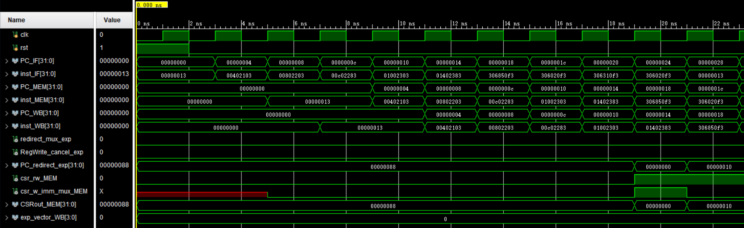
Simulation (1)

Slide 42
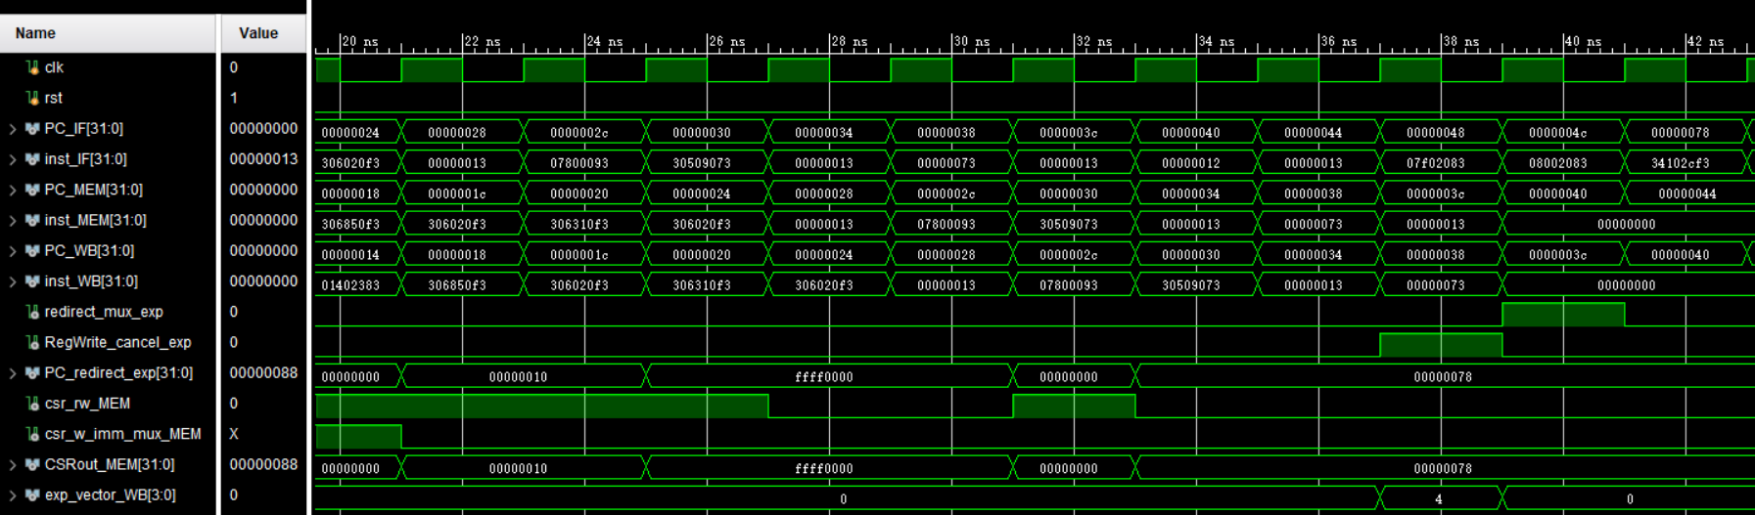
Simulation (2)

Slide 43
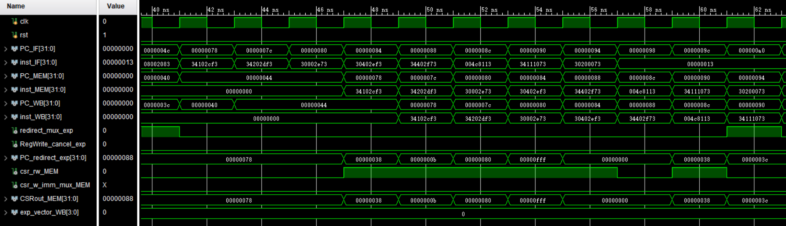
Simulation (3)

Slide 44
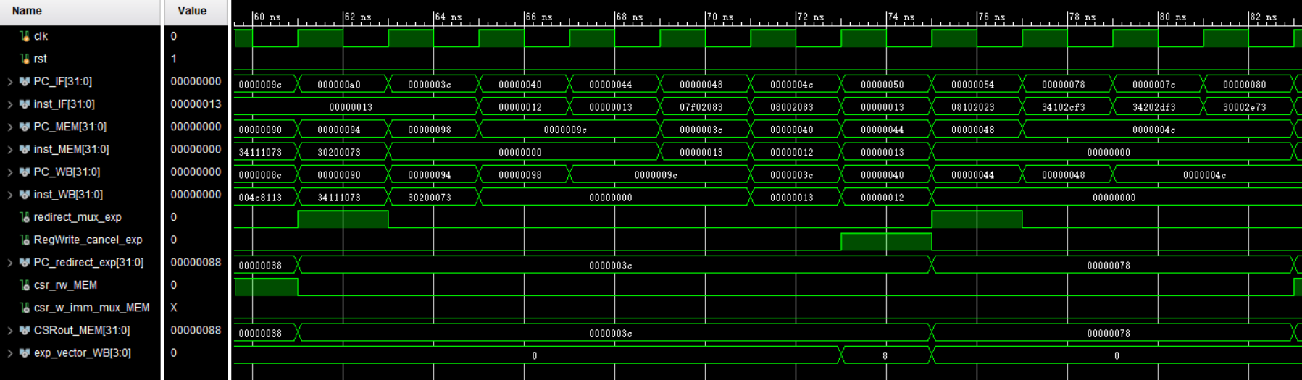
Simulation (4)

Slide 45
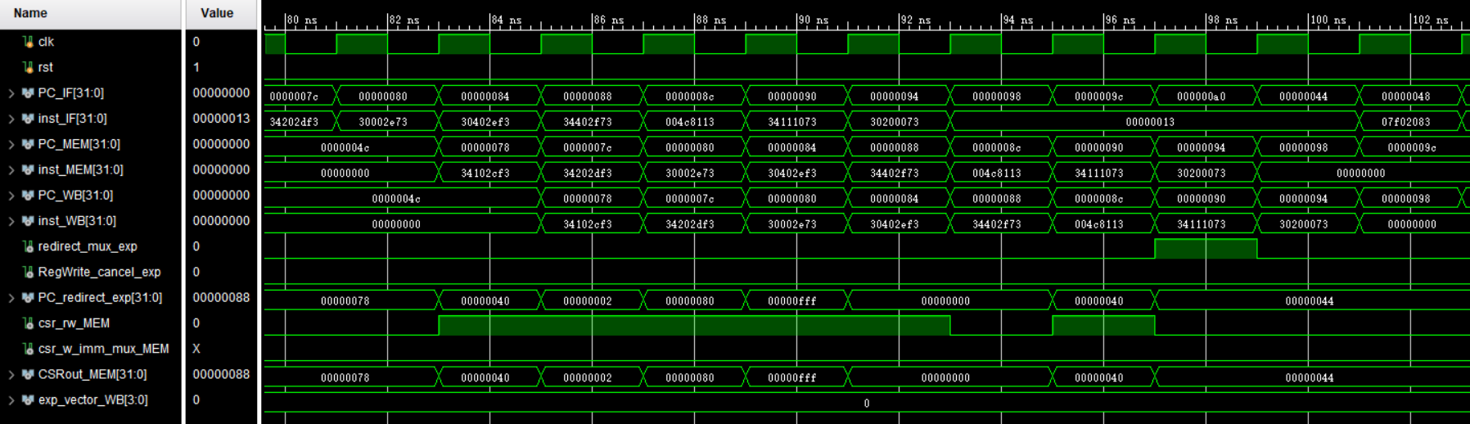
Simulation (5)

Slide 46
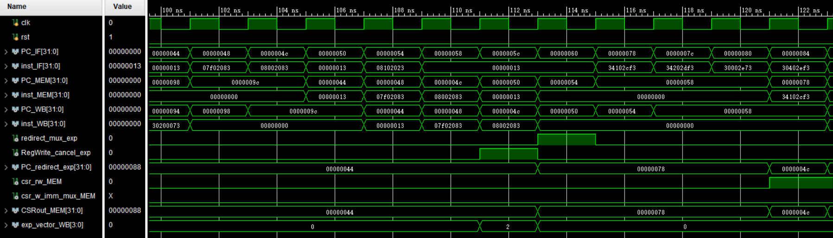
Simulation (6)

Slide 47
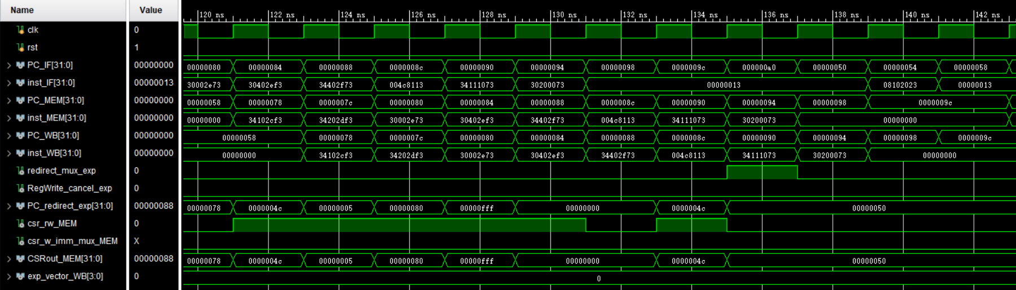
Simulation (7)

Slide 48
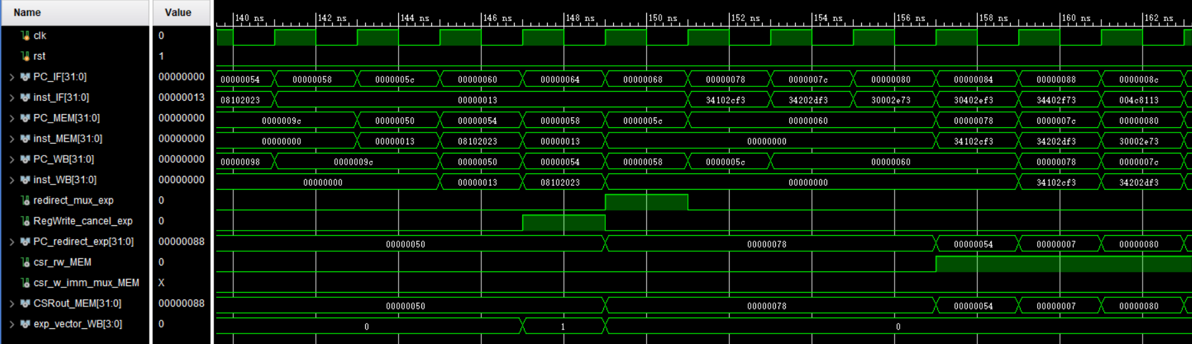
Simulation (8)

Slide 49
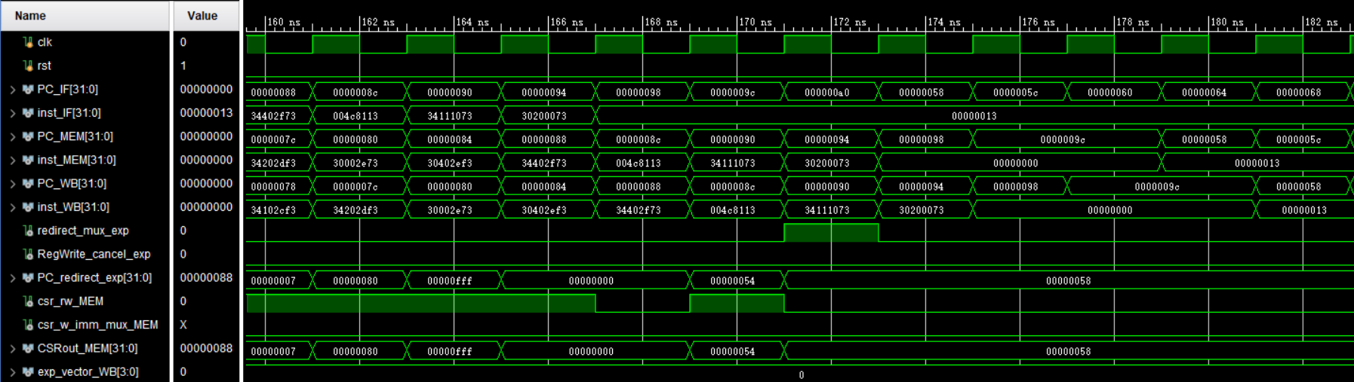
Simulation (9)

Slide 50
Checkpoints
CP 1:
Waveform Simulation of the Pipelined CPU with the verification program
CP 2:
FPGA Implementation of the Pipelined CPU with the verification program

Slide 51
Thanks!

